Slide 1

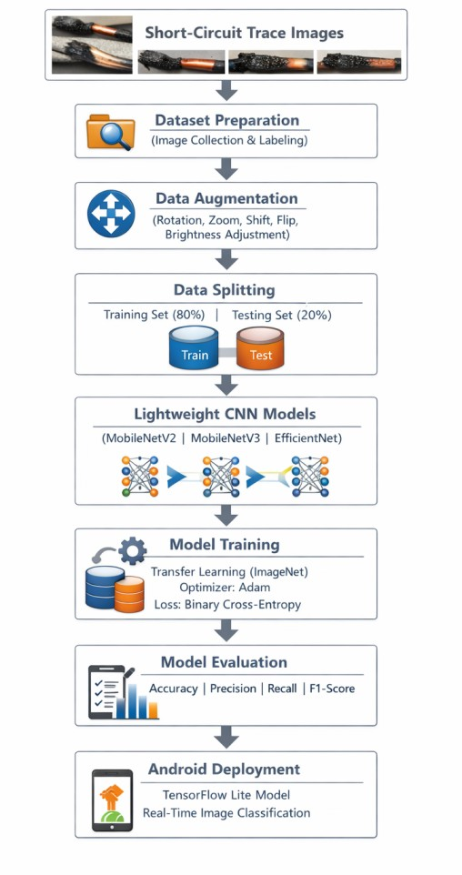
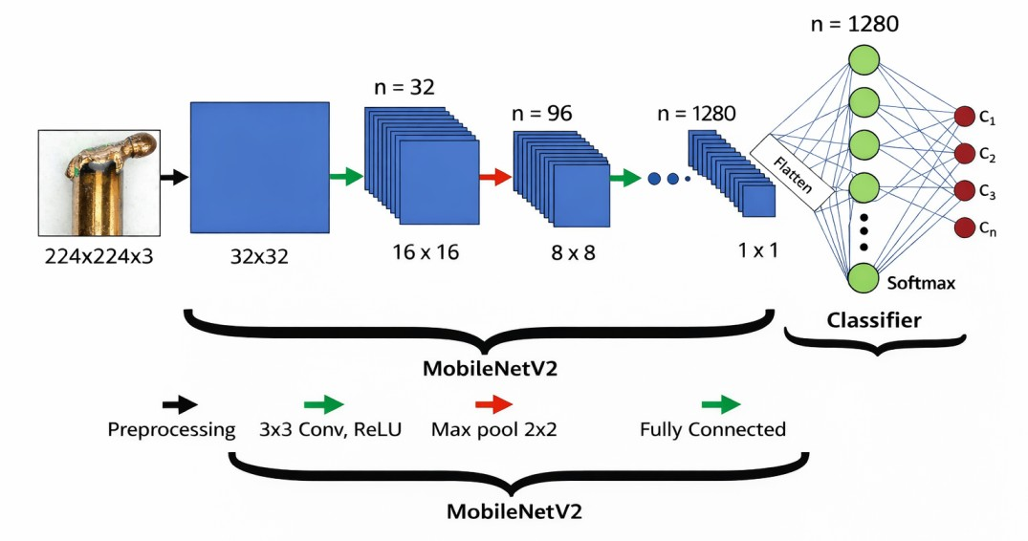
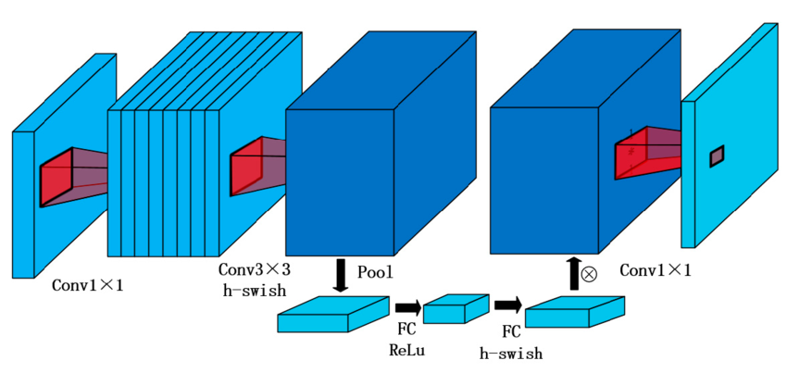
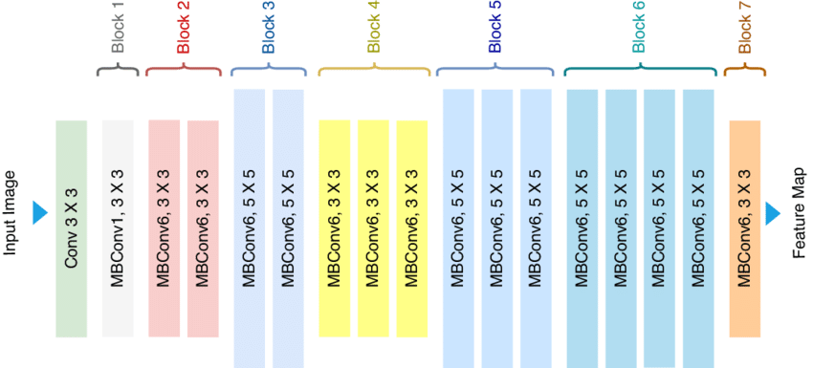
Lightweight Deep Learning for Electric Fire Short-Circuit marks Classification Using MobileNetV2
모바일넷V2를 활용한 전기화재 단락흔 판별을 위한 경량 딥러닝 모델
Nazari Mohammad Hadi * , Junho Bang†, Deunchan Kim * *, Soyeon Park * *, Zhaojie * *
Jeonbuk National University, Dept. of IT Applied System Engineering *, †, * *
하디 *, 방준호†, 김든찬 * *, 박소연 * *, 조걸 * *,
전북대학교, IT응용시스템공학과*, †, * *
Abstract
Electrical short circuits are a major cause of electrical fires, making accurate trace identification essential for fire investigations. This paper evaluates three lightweight deep learning models MobileNetV2, MobileNetV3, and EfficientNet for classifying PSCT and SSCT using a dataset of 752 images (80% training, 20% testing) with data augmentation and transfer learning. EfficientNet achieved the highest accuracy (96.05%), while MobileNetV3 showed the lowest validation loss, confirming the effectiveness of lightweight CNN models.
Introduction
Electrical fires pose serious risks, requiring accurate identification of their origin. Short-circuit traces are classified as PSCT (before ignition) and SSCT (after ignition). This paper evaluates lightweight CNN models MobileNetV2, MobileNetV3, and EfficientNet for automated classification and explores their use in practical fire investigation systems.
Related Work
Deep learning, especially CNNs, is widely used for image classification. While models like AlexNet, VGGNet, and ResNet improved accuracy, they require high computational resources. To address this, lightweight models such as MobileNetV2, MobileNetV3, and EfficientNet are used, offering efficient performance with reduced complexity while maintaining strong feature extraction.
<Figure 1> MobileNetV2 network architecture
<Figure 5> Proposed Framework for Electric Fire Short-Circuit Trace Classification
Model performance
<Figure 2> Block structure of MobileNetV3
Model | Training Accuracy | Validation Accuracy | Validation Loss
MobileNetV2 | 91.39% | 92.76% | 0.1523
MobileNetV3 | 93.59% | 95.39% | 0.1044
EfficientNet | 91.65% | 96.05% | 0.1739
Conclusions
<Figure 3> Architecture of EfficientNet
Lightweight CNN models effectively classify electric fire short-circuit traces with high accuracy and low computational cost, making them suitable for resource constrained devices. EfficientNet achieved the highest validation accuracy (96.05%), while MobileNetV3 showed stable performance with the lowest validation loss. These results confirm the potential of lightweight models for automated fire investigation systems, with future work focusing on dataset expansion and mobile application development.
Proposed Approach
The dataset includes 752 images of electric short-circuit traces (PSCT and SSCT), resized to 224×224. EfficientNet achieved the highest accuracy (96.05%), while MobileNetV3 showed the lowest validation loss. Data augmentation (rotation, shift, shear, zoom, flip) improved generalization, and the Adam optimizer was used for efficient training.
This work was supported by the Korea Institute of Energy Technology Evaluation and Planning(KETEP) grant funded by the Korea government(MCEE)(RS-2022-KP002707, Jeonbuk Regional Energy Cluster Training of human resources).

